Slide 1

AgentTwinDefect AI: An Agentic Digital Twin Platform for Real-Time Hidden Defect Prediction in Smart Manufacturing
SOA Project Review-4
Thursday, October 1st, 2026
 | Under the Guidance of Dr. Srikanth Cherukuvada Assistant Professor, Department of Computer Science and Engineering, KLH CSE Bowrampet Campus
Team Members K.AMULYA – 2420090132 P.SAHASRA – 2420090128 S.SUSHMITA – 2420090076

Slide 2
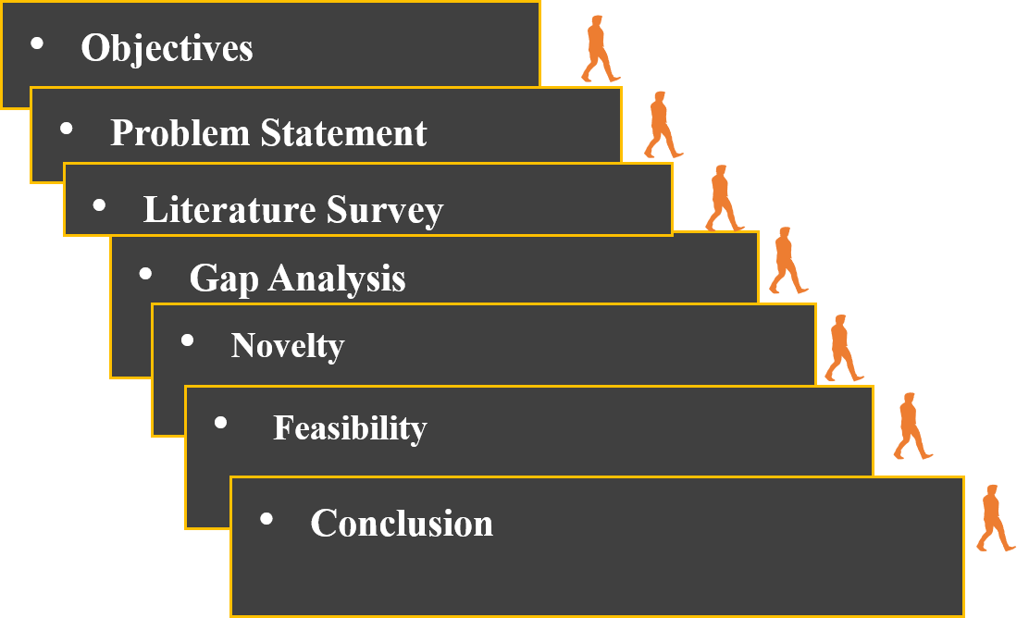

Outline of Research Work

Slide 3

OBJECTIVES
Develop a Digital Twin of a manufacturing process for real-time monitoring.
Collect and process sensor/process data such as temperature, vibration, speed and pressure.
Predict emerging/hidden defects using ML models.
Deploy AI agents for defect analysis and root-cause identification.
Simulate corrective actions using the Digital Twin.
Recommend the best corrective action based on predicted outcomes.
Provide a real-time dashboard for monitoring, alerts and explanations.
3

Slide 4
PROBLEM STATEMENT
Modern smart manufacturing systems generate large volumes of heterogeneous, real-time data from sensors, machines, and production processes. Although Digital Twins and Machine Learning can be used for process monitoring and defect prediction, existing approaches often operate as separate systems and primarily focus on detecting anomalies or predicting failures. They provide limited support for identifying the probable root causes of hidden product defects and evaluating corrective actions before applying them to the physical process.
The key problem is therefore the absence of an integrated, real-time and intelligent framework that can continuously monitor manufacturing processes, predict emerging defects, reason about their possible causes, simulate alternative corrective actions using a Digital Twin, and recommend an appropriate intervention. AgentTwinDefect AI addresses this gap by combining an Agentic AI layer with a Digital Twin and predictive models to establish a closed-loop workflow from process monitoring and defect prediction to diagnosis, what-if simulation, and corrective-action recommendation.
3

Slide 5
LITERATURE REVIEW
Paper Link | Paper | Methodology | Drawback | Relevance to Our Project
https://doi.org/10.3389/frai.2025.1655470 | Generative and Predictive AI for Digital Twin Systems in Manufacturing | AI-enabled Digital Twin combining Generative AI and Predictive AI; sensor-based defect prediction and virtual testing. | Agentic AI is not implemented; study is demonstrated in a specific welding context. | AI + Digital Twin + defect prediction → add agentic reasoning and corrective-action support.
https://doi.org/10.1016/j.ifacol.2025.12.403 | An Agentic AI-based Architecture for Digital Twins Specialized in Predictive Maintenance | Semi-autonomous multi-agent architecture with Predictive Maintenance and Quality Assurance agents integrated with a Digital Twin. | Mainly addresses predictive maintenance/equipment behaviour; data quality, integration and real-time responsiveness remain challenges. | Multi-agent reasoning + Digital Twin → apply to hidden product-defect diagnosis and corrective actions.
https://doi.org/10.3390/jmmp9030079 | Transforming Manufacturing Quality Management with Cognitive Twins | Cognitive Twin with ML and real-time manufacturing data for proactive quality management and predictive optimization. | Prototype/flexible-manufacturing setting; generalisation, infrastructure, cybersecurity and integration remain concerns. | Real-time quality monitoring + prediction → extend with agentic reasoning and what-if action selection.
https://doi.org/10.1038/s41598-026-58348-7 | Digital Twin-driven Multiscale Modelling for Real-Time Defect Prediction in Metal Additive Manufacturing | Digital Twin + physics-informed neural networks + CNN-LSTM + IoT/edge/fog/cloud for real-time defect prediction. | Domain-specific to metal additive manufacturing; computationally complex and primarily prediction-focused. | Real-time DT defect prediction → add diagnosis, simulation and recommendation.
https://doi.org/10.1016/j.rcim.2023.102581 | Multisensor Fusion-based Digital Twin for Localized Quality Prediction in Robotic L-DED | Multisensor fusion using vision, microphone and thermal-camera data with a Digital Twin for localized quality prediction. | Specific to robotic laser-directed energy deposition; no autonomous corrective-action reasoning. | Multimodal sensing + DT quality prediction → use richer process-state features.

Slide 6
LITERATURE REVIEW
Paper Link | Paper | Methodology | Drawback | Relevance to Our Project
https://doi.org/10.1016/j.infsof.2022.107008 | Predictive Maintenance Using Digital Twins: A Systematic Literature Review | Systematic review of DigitalTwin-enabled predictive maintenance studies, architectures, ML approaches and communication protocols. | Maintenance-focused rather than product-defect management; highlights data variety, computational and model/asset complexity. | DT architecture challenges and design considerations → inform system integration and scalability.
https://doi.org/10.1016/j.jmsy.2023.10.010 | The Advance of Digital Twin for Predictive Maintenance: The Role and Function of Machine Learning | Review of ML roles in DT-based predictive maintenance and framework for ML-enabled DT-PdM. | Primarily equipment health/maintenance; limited focus on hidden product defects and corrective-action simulation. | Separate DT and predictive-ML roles → integrate them with an agentic decision layer.
https://doi.org/10.1016/j.aei.2024.102800 | A Requirement-Based Roadmap for Standardized Predictive Maintenance Automation Using Digital Twin Technologies | Requirement-based roadmap using informational and functional requirements for DT-based predictive-maintenance automation. | Roadmap/review rather than a complete executable closed-loop defect system. | Functional requirements + system integration → define the executable architecture before implementation.
https://doi.org/10.12688/digitaltwin.17807.2 | Digital Twins Along the Product Lifecycle: A Systematic Literature Review of Applications in Manufacturing | Systematic review mapping Digital Twin applications across the manufacturing product lifecycle. | Many applications remain early-stage/prototype-oriented; lifecycle coverage and maturity vary across studies. | Supports an extensible, integrated DT architecture rather than a single-purpose model.
https://doi.org/10.1038/s41598-024-63990-0 | Digital Twin-Driven Prognostics and Health Management for Industrial Assets | Systematic analysis of DT-driven prognostics and health management across application, theory and implementation layers. | Asset-health focus; real-time perception, feedback and integration with intelligent decision systems remain challenges. | Data → virtual model → decision-support structure → extend toward closed-loop quality intelligence.
2

Slide 7
GAP ANALYSIS THROUGH LITERATURE
• Existing Digital Twin systems can monitor and predict, but autonomous reasoning about why a hidden product defect may occur is less developed.
• Agentic Digital Twin research is emerging, but many demonstrated architectures emphasize predictive maintenance and equipment behavior rather than product-quality defects.
• Real-time integration remains constrained by data quality, heterogeneous sensor streams, latency, computational complexity and system interoperability.
• Prediction, root-cause analysis, virtual corrective-action testing and final recommendation are usually treated as separate capabilities, But our proposed system wants to connect these stages.
• Limited end-to-end closed-loop architectures connect a predicted defect to simulated corrective actions and measurable decision outcomes.
RESEARCH GAP:
Need for an integrated agentic Digital Twin that predicts emerging product defects, reasons about probable causes, evaluates corrective actions in simulation, and recommends the most suitable action in real time.
9

Slide 8
Innovation, Creativity, and Novelty
1. Prediction-to-Action Approach
Goes beyond simply predicting machine defects/failures.
Converts the predicted risk into a corrective decision-making process.
2. Agentic Decision Engine
Generates multiple possible corrective actions.
Analyzes failure risk and probable contributing factors instead of providing only an alert.
3. Digital Twin-Based What-If Testing
Virtually tests each corrective action before physical implementation.
Allows comparison of different possible machine/process conditions.
4. Quantitative Solution Comparison
Compares candidate actions using:
  Predicted failure risk
  Risk reduction
  Constraint satisfaction
5. Closed-Loop Intelligent Workflow:
Monitor → Predict → Generate → Simulate → Compare → Recommend → Monitor
9

Slide 9
FEASIBILITY
Technical Feasibility
Python-based ML model development
Random Forest for initial failure prediction
Agentic decision layer for corrective-action generation
Digital Twin for virtual what-if simulation
Web-based interface for visualization
Data Feasibility
Public predictive-maintenance datasets available
Manufacturing parameters such as temperature, speed, torque, and process conditions
Dataset can be used for initial model development and evaluation
Implementation Feasibility
Modular architecture
ML, Agentic AI, and Digital Twin components can be developed independently
APIs can connect the individual modules
Incremental development allows testing at every stage
Practical Feasibility
Initial implementation can be performed using software-based simulation
Physical industrial equipment is not required for the prototype
Digital Twin allows virtual testing of corrective actions
9

Slide 10
FEASIBILITY & PROJECT PLAN
4. ML Model Development: Train and evaluate the Machine Learning model to predict machine failure/defect risk.
5. Agentic Decision Engine: Develop the agentic layer to analyze failure risk and generate possible corrective actions.
6. Digital Twin Development: Build the virtual machine/process model for testing corrective actions through what-if simulation.
7. System Integration: Connect the ML model, Agentic Decision Engine, Digital Twin, and recommendation components.
8. Testing & Evaluation: Test the complete system and evaluate prediction accuracy, risk reduction, and decision performance.
Phase | Work
Phase 1 | Problem identification and literature review
Phase 2 | Research gap and requirement analysis
Phase 3 | Dataset collection and preprocessing
Phase 4 | ML model development and evaluation
Phase 5 | Agentic Decision Engine development
Phase 6 | Digital Twin and what-if simulation
Phase 7 | Integration and corrective recommendation
Phase 8 | Testing, evaluation and documentation
1. Problem Identification: Identify the manufacturing failure/defect prediction problem and define the project objectives.
2. Literature Review: Study existing Machine Learning, Agentic AI, and Digital Twin approaches related to manufacturing.
3. Gap Analysis: Identify limitations in existing approaches and define how our system addresses those gaps.
9

Slide 11
RELEVANCE TO PROJECT TITLE
Why AgentTwinDefect AI is aligned with OUR PROJECT TITLE
Title Component | Relevance to Our Project
Agentic | Provides task-oriented reasoning to analyze predicted defects, investigate probable causes, and support corrective-action decisions.
Digital Twin | Maintains a virtual representation of the manufacturing process and enables what-if simulation of process conditions.
Defect Prediction | Uses ML models and process/sensor data to identify patterns associated with emerging or hidden product-quality defects.
Real-Time | Enables continuous processing of incoming manufacturing data so that defect risks can be identified with minimal delay.
Smart Manufacturing | Targets data-driven, connected manufacturing environments where process monitoring, prediction, simulation, and decision support are integrated.
Agentic
Digital Twin
Defect
AI
Autonomous reasoning + task-specific agents
Virtual process state + what-if simulation
Emerging / hidden product-quality anomaly
Prediction + diagnosis + decision support
3

Slide 12
SIGNIFICANCE OF THE PROJECT
Early Defect Detection
Predict emerging defects before they propagate into downstream quality failures.
2. Root-Cause Intelligence
Go beyond prediction by identifying probable process factors contributing to the defect.
3. What-If Simulation
Use the Digital Twin to test corrective actions virtually before changing the physical process.
4. Intelligent Decision Support
Agentic AI connects prediction, diagnosis, simulation, and recommendation.
5. Reduced Quality Loss
Potentially reduce rework, scrap, downtime, and trial-and-error interventions.
6. Scalable Smart-Manufacturing Foundation
Provides an extensible architecture for additional sensors, models, machines, and production lines.
4
Notes:
What-If simulation - Before actually changing something in the real manufacturing process, we virtually change the parameter in the Digital Twin and see what might happen.

Slide 13
CRITICAL ANALYSIS & SYNTHESIS
DIGITAL TWIN:
Literature consistently demonstrates the use of Digital Twins for virtual representation, process monitoring, synchronization, simulation, predictive maintenance, and quality-related applications.
2. PREDICTIVE AI: MAT
ML, DL, multi-sensor fusion, and physics-informed models have demonstrated the ability to detect anomalies and predict defects, failures, or quality risks from manufacturing process data.
3. AGENTIC AI:
Recent studies introduce agentic and multi-agent architectures for Digital Twin environments. However, current applications are largely oriented toward predictive maintenance rather than hidden product-defect management.
4. REAL-TIME INTEGRATION:
Across the literature, data heterogeneity, data quality, communication latency, computational complexity, model integration, and real-time synchronization remain important implementation challenges.
5. DECISION SUPPORT: IDENTIFIED GAP
Most existing approaches primarily terminate at monitoring, prediction, diagnosis, or maintenance recommendation. Limited work connects defect prediction with root-cause reasoning and virtual evaluation of corrective actions.
6. SYNTHESIZED RESEARCH GAP
The literature indicates an opportunity for an integrated quality-intelligence framework that connects real-time defect prediction, root-cause reasoning, Digital Twin-based what-if simulation, and corrective-action recommendation within a unified workflow.

Slide 14
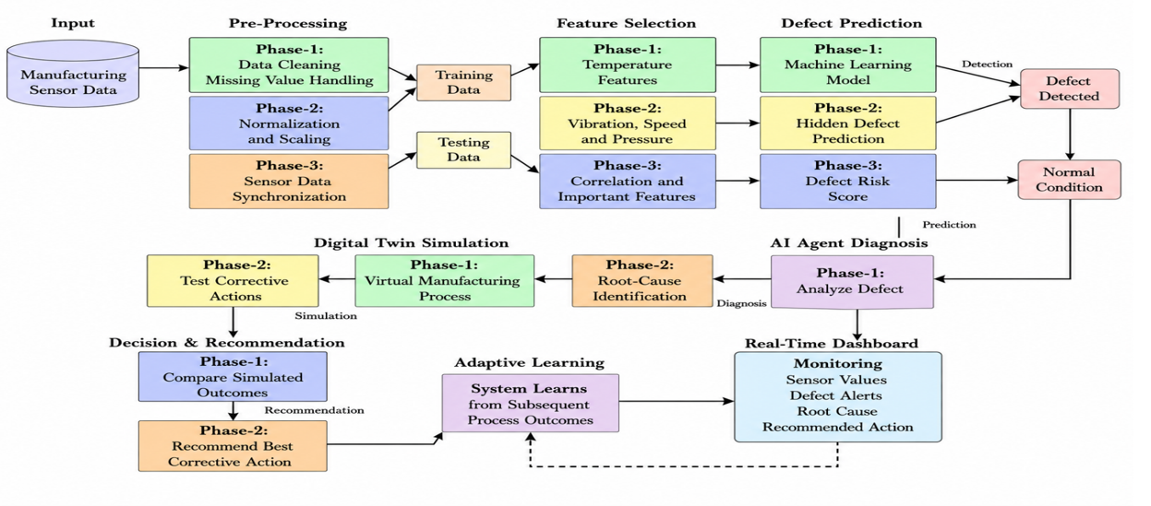
PROPOSED SYSTEM ARCHITECTURE
10

Slide 15
IMPLEMENTATION
Frontend | Provides the user-facing interface for monitoring the manufacturing process, displaying process parameters, defect-risk alerts, probable causes, simulation results, and corrective-action recommendations.
Backend | Acts as the integration layer between the frontend and computational services. It receives process data through APIs, validates and normalizes the input, invokes required services, and returns structured responses.
ML Inference | Processes the supplied manufacturing parameters and applies the trained ML model to estimate defect probability, classify the potential defect, and provide the associated confidence or risk level.
Digital Twin | Maintains a virtual representation of the manufacturing process and its current state. It updates the virtual state using process data and supports what-if simulation for evaluating alternative process conditions.
Agentic Layer | Provides task-oriented reasoning over prediction and simulation outputs. It analyses probable defect causes, evaluates candidate corrective actions, compares their expected outcomes, and generates a recommendation.
Integration | Demonstrates the complete end-to-end workflow in which process data flows from the frontend through the backend, ML inference, Digital Twin and agentic reasoning layers, with the final result returned to the dashboard.
13

Slide 16
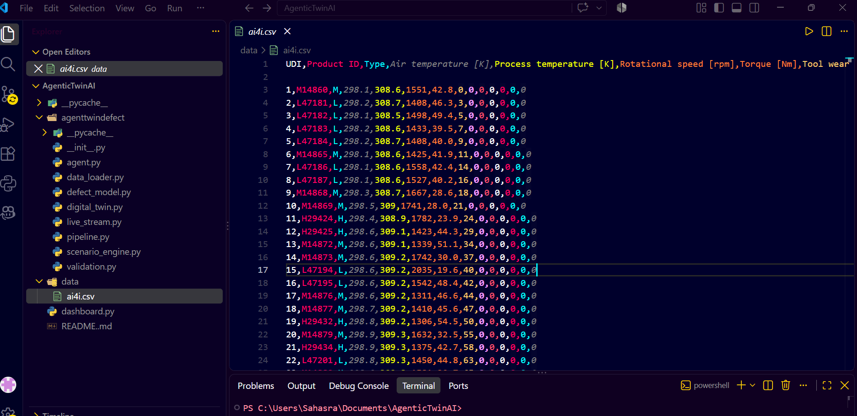
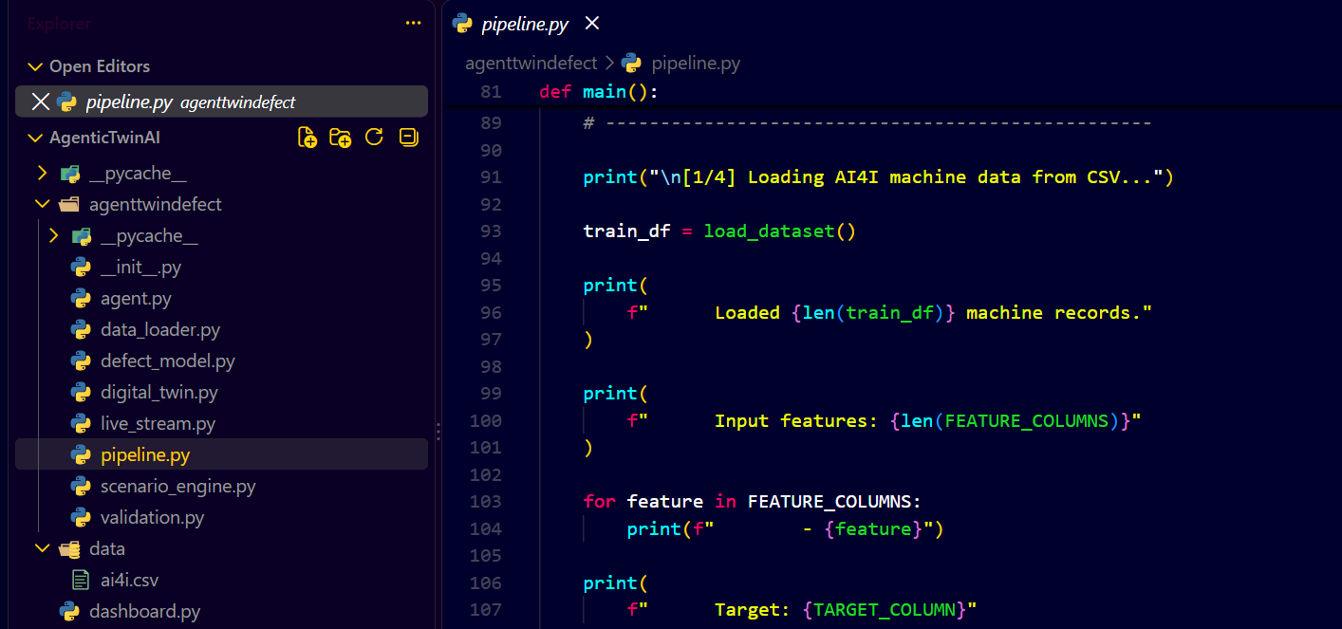
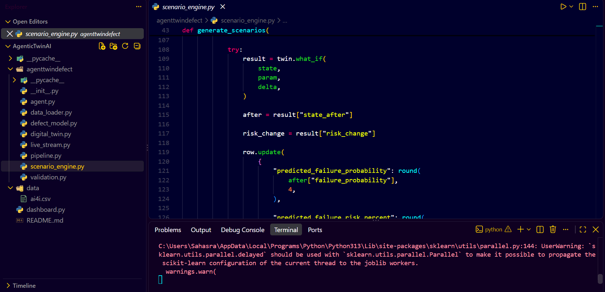
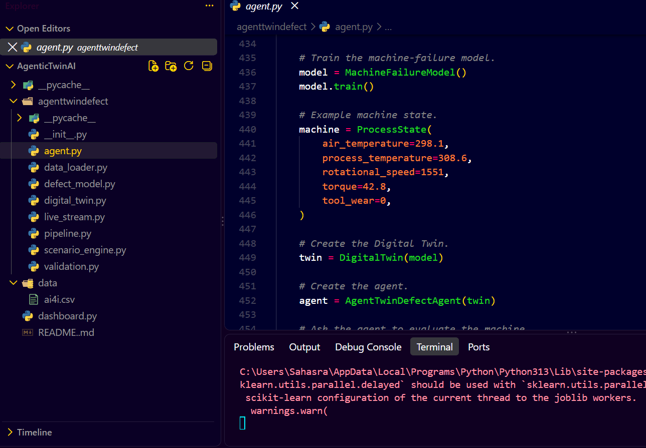

Slide 17
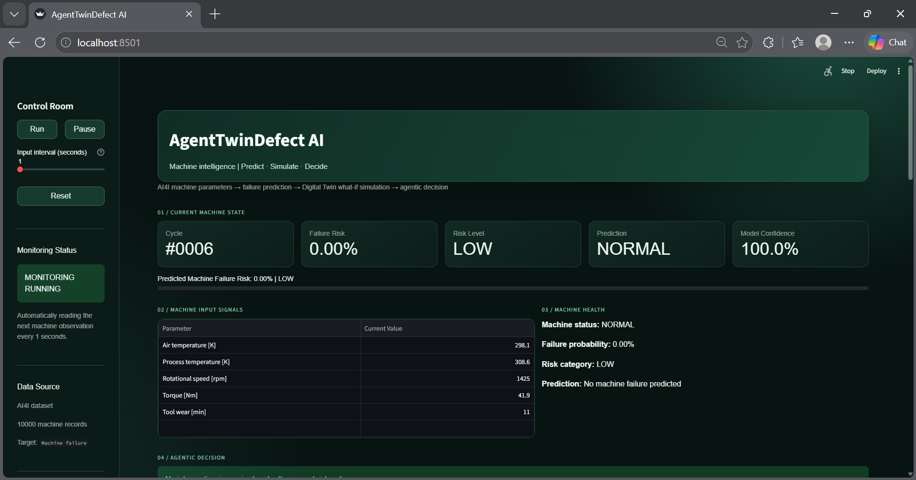
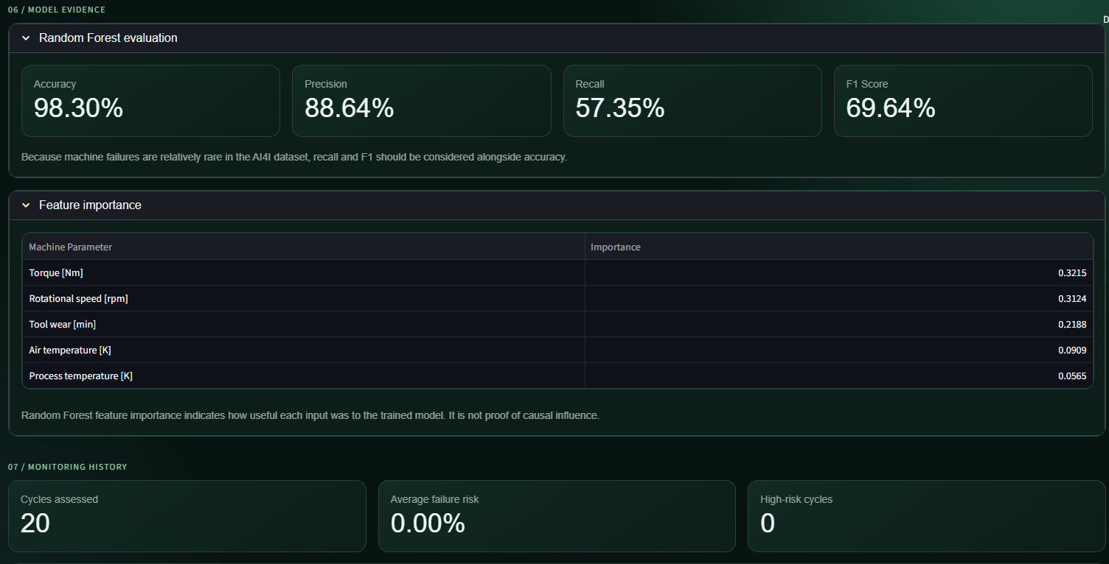
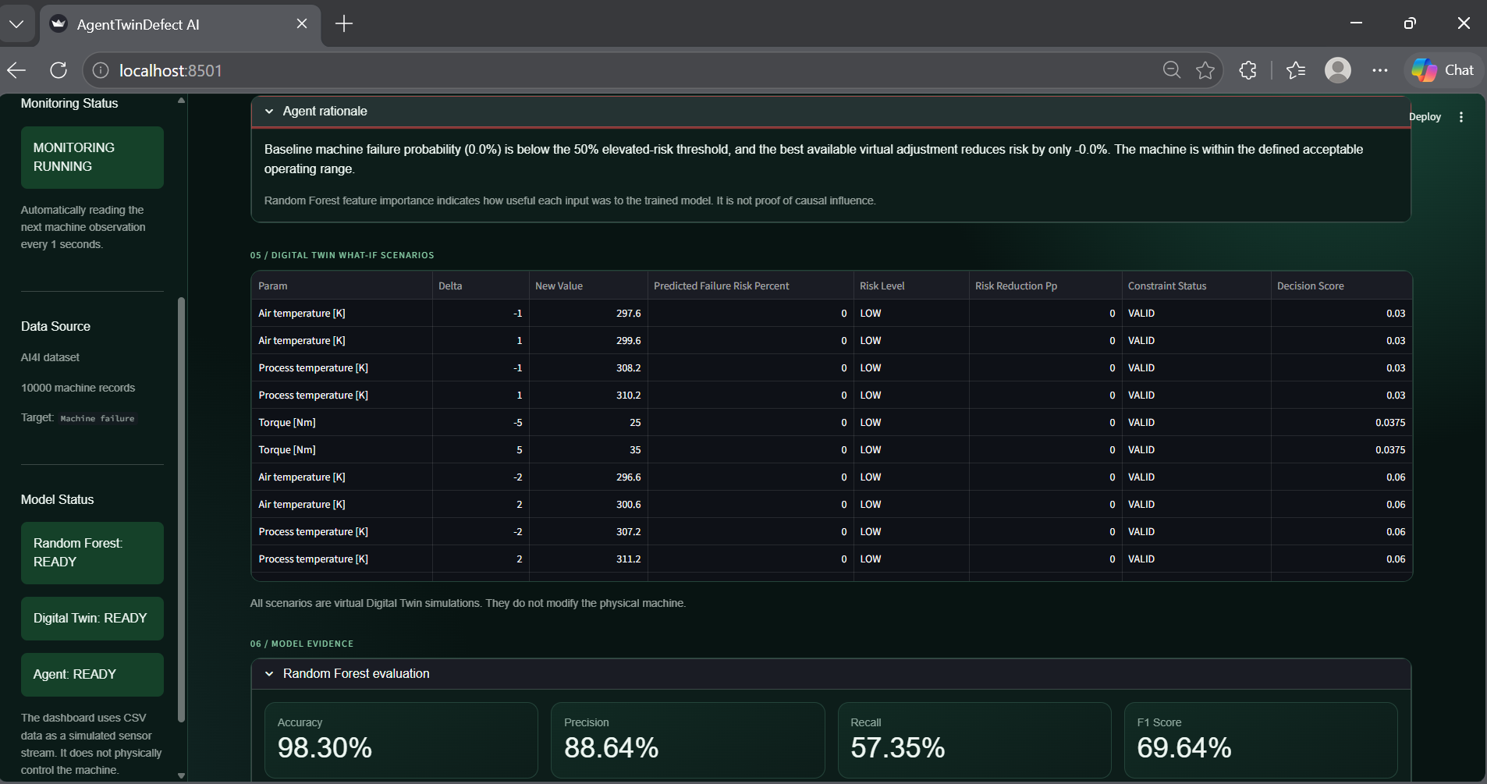
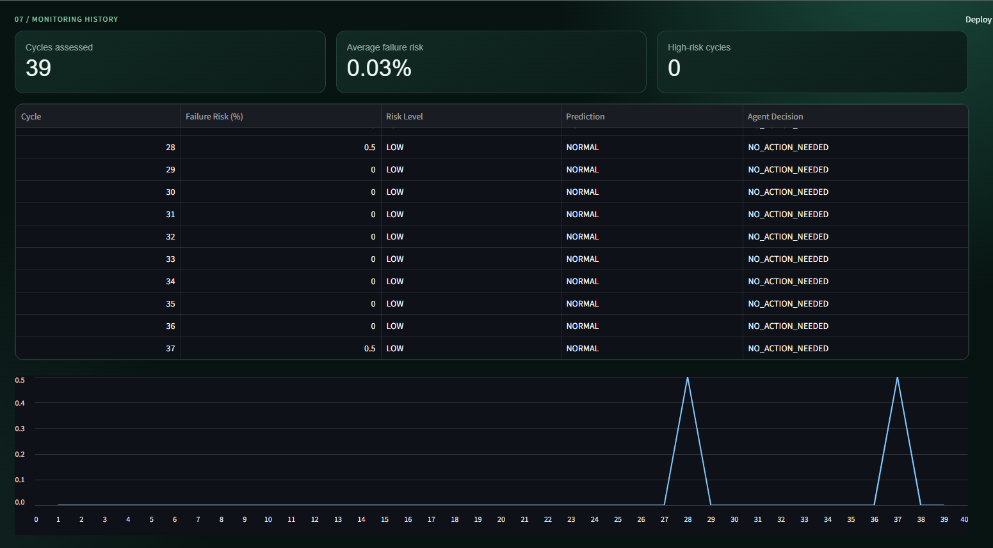

Slide 18
THANK YOU
18

